Slide 1
[220 / 319] Randomness
Meena Syamkumar
Andy Kuemmel

Slide 2
Announcements
Follow-up courses
Direct follow up course: CS 320
Computer Sciences: CS 200, 300, 400, 537, 564, 640
Office Hours
Last day of TA / PM office hours: Wednesday Dec 15th.
Additional instructor office hours

Slide 3
Final exam
Recommended prep
review past exam question papers
make sure you understand all the worksheet problems
review the readings, slides, lecture demo code
review everything you got wrong on the midterms
prepare a note sheet
Live review session on Wednesday Dec 15th
All are welcome to attend

Slide 4
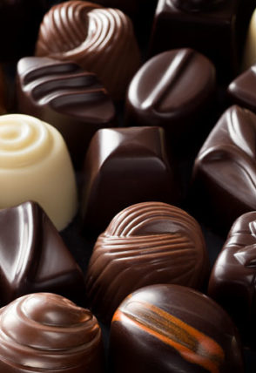
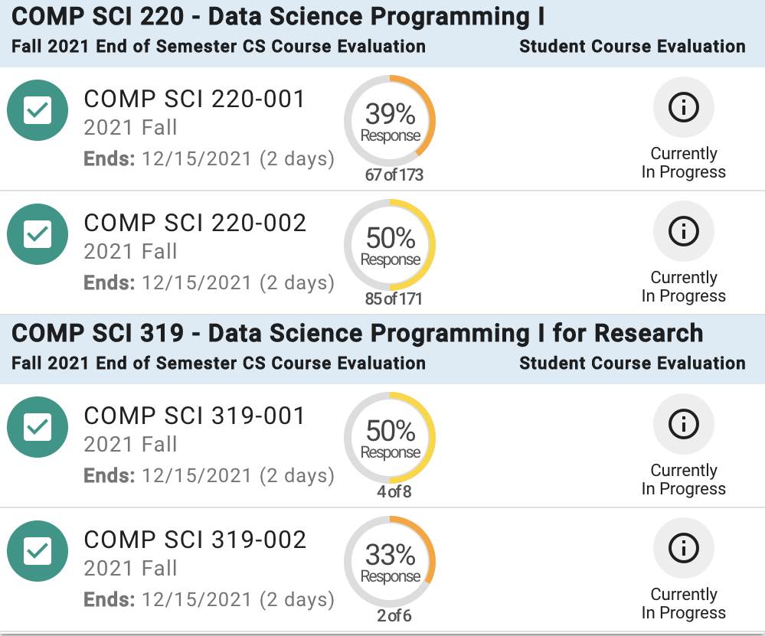
Course evaluations
https://health.clevelandclinic.org/dark-milk-or-white-which-chocolate-is-best-for-your-heart/
We value student feedback greatly
Please bring a smile to your instructors' face by spending a few minutes to fill out evals ☺
Login to https://aefis.wisc.edu/
Find the CS220 / CS319 lecture and please provide feedback

Slide 5
Recommended reading
Fluent Python: Clear, Concise,
and Effective Programming
by Luciano Ramalho
Think Python: How to Think
Like a Computer Scientist
by Allen B. Downey

Slide 6
Recommended reading
Data analysis:
Data Action: Using Data for Public Good by Sarah Williams
SQL:
Learning SQL: Generate, Manipulate, and Retrieve Data by Alan Beaulieu
SQL Cookbook by Anthony Molinaro
Visualization:
The Visual Display of Quantitative Information by Edward R. Tufte
Statistics:
Thinking, Fast and Slow by Daniel Kahneman
The Signal and the Noise by Nate Silver
Statistics Done Wrong by Alex Reinhart

Slide 7
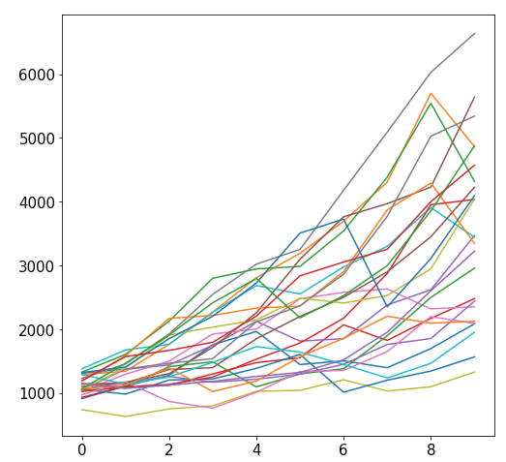
Why Randomize?
Games
Security
Simulation
our focus

Slide 8
Outline
choice()
bugs and seeding
significance
histograms
normal()

Slide 9
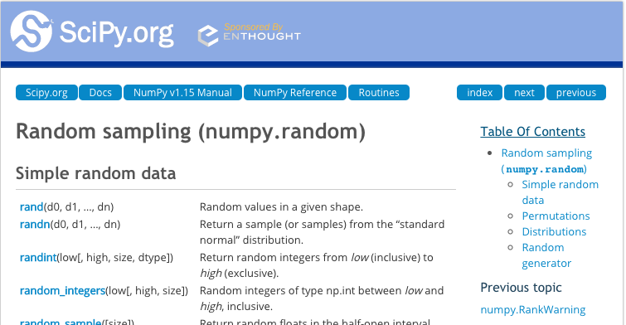
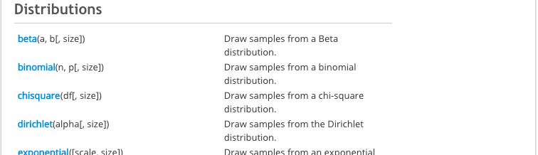
New Functions Today
numpy.random:
powerful collection of functions
choice
Series.plot.hist:
similar to bar plot
visualize spread of random results
powerful collection of functions

Slide 10
choice
from numpy.random import choice
result = choice([<choice1, choice2, …])
list of things to
randomly choose from

Slide 11
choice
from numpy.random import choice
result = choice(["rock", "paper", "scissors"])
list of things to
randomly choose from
https://www.securifera.com/blog/2015/09/09/mmactf-2015-rock-paper-scissors-rps/

Slide 12
choice
from numpy.random import choice
result = choice(["rock", "paper", "scissors"])
print(result)
Output:
scissors
https://www.securifera.com/blog/2015/09/09/mmactf-2015-rock-paper-scissors-rps/

Slide 13
choice
from numpy.random import choice
result = choice(["rock", "paper", "scissors"])
print(result)
result = choice(["rock", "paper", "scissors"])
print(result)
Output:
scissors
rock
each time choice is
called, a value is randomly
selected (will vary run to run)

Slide 14
choice
from numpy.random import choice
choice(["rock", "paper", "scissors"], size=5)
for simulation, we'll often want
to compute many random results

Slide 15
choice
from numpy.random import choice
choice(["rock", "paper", "scissors"], size=5)
array(['rock', 'scissors', 'paper', 'rock', 'paper'], dtype='<U8')
it's list-like

Slide 16
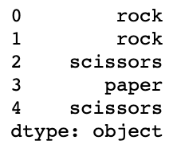
Random values and Pandas
from numpy.random import choice
# random Series
Series(choice(["rock", "paper", "scissors"], size=5))

Slide 17
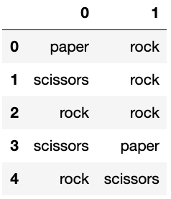
Random values and Pandas
from numpy.random import choice
# random Series
DataFrame(choice(["rock", "paper", "scissors"],
size=(5,2)))

Slide 18
Demo: exploring bias
choice(["rock", "paper", "scissors"])
Question 1: how can we make sure the randomization isn't biased?

Slide 19
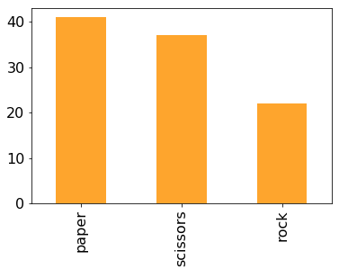
Demo: exploring bias
choice(["rock", "paper", "scissors"])
Question 1: how can we make sure the randomization isn't biased?

Slide 20
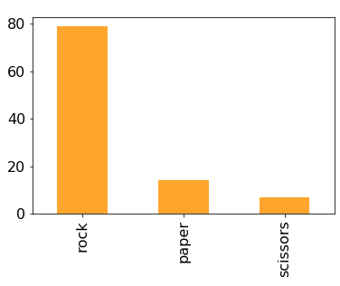
Demo: exploring bias
choice(["rock", "paper", "scissors"])
Question 1: how can we make sure the randomization isn't biased?
Question 2: how can we make it biased (if we want it to be)?
p=[...]

Slide 21
Random Strings vs. Random Ints
from numpy.random import choice, normal
# random string: rock, paper, or scissors
choice(["rock", "paper", "scissors"])
# random int: 0, 1, or 2
choice([0, 1, 2])
# random int (approach 2): 0, 1, or 2
choice(3)
same
random non-negative int
that is less than 3

Slide 22
Outline
choice()
bugs and seeding
significance
histograms
normal()

Slide 23
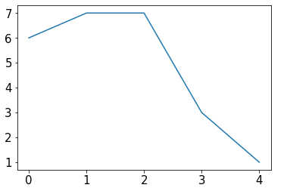
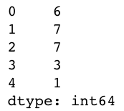
Example: change over time
s = Series(choice(10, size=5))
s.plot.line()

Slide 24
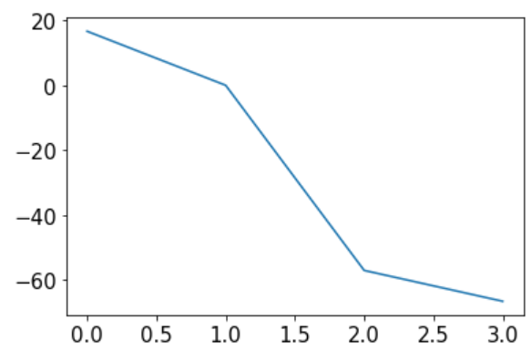
Example: change over time
s = Series(choice(10, size=5))
s.plot.line()
percents = []
for i in range(1, len(s)):
diff = 100 * (s[i] / s[i-1] - 1)
percents.append(diff)
Series(percents).plot.line()
what are we computing for diff?

Slide 25
Example: change over time
s = Series(choice(10, size=5))
s.plot.line()
percents = []
for i in range(1, len(s)):
diff = 100 * (s[i] / s[i-1] - 1)
percents.append(diff)
Series(percents).plot.line()
can you identify the bug in the code?

Slide 26
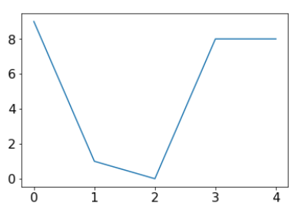
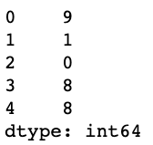
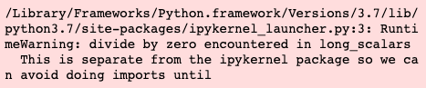
Example: change over time
s = Series(choice(10, size=5))
s.plot.line()
percents = []
for i in range(1, len(s)):
diff = 100 * (s[i] / s[i-1] - 1)
percents.append(diff)
Series(percents).plot.line()
can you identify the bug in the code?

Slide 27
Not all bugs are equal!
scary bugs
"nice" bugs
non-deterministic
deterministic (reproducible)
system related
randomness
https://owlcation.com/stem/5-Badass-Bugs-That-You-Should-Have-Nightmares-About

Slide 28
Not all bugs are equal!
scary bugs
"nice" bugs
non-deterministic
deterministic (reproducible)
system related
randomness
large data
small data
semantic
syntax
runtime
https://owlcation.com/stem/5-Badass-Bugs-That-You-Should-Have-Nightmares-About

Slide 29
Not all bugs are equal!
scary bugs
"nice" bugs
non-deterministic
deterministic (reproducible)
system related
randomness
large data
small data
semantic
????
syntax
runtime
https://owlcation.com/stem/5-Badass-Bugs-That-You-Should-Have-Nightmares-About

Slide 30
Not all bugs are equal!
scary bugs
"nice" bugs
non-deterministic
deterministic (reproducible)
system related
randomness
seeding
large data
small data
semantic
assert
syntax
runtime
https://owlcation.com/stem/5-Badass-Bugs-That-You-Should-Have-Nightmares-About

Slide 31
Pseudorandom Generators
"Random" generators are really just pseudorandom
684 559 629 192 835 ...
37 235 908 72 767 ...
168 527 493 584 534 ...
874 664 249 643 952 ...

Slide 32
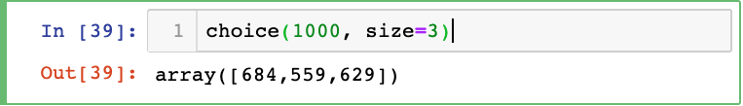
Pseudorandom Generators
"Random" generators are really just pseudorandom
684 559 629 192 835 ...
37 235 908 72 767 ...
168 527 493 584 534 ...
874 664 249 643 952 ...

Slide 33
Pseudorandom Generators
"Random" generators are really just pseudorandom
684 559 629 192 835 ...
37 235 908 72 767 ...
168 527 493 584 534 ...
874 664 249 643 952 ...

Slide 34
Pseudorandom Generators
"Random" generators are really just pseudorandom
seeds
684 559 629 192 835 ...
37 235 908 72 767 ...
168 527 493 584 534 ...
874 664 249 643 952 ...
100:
101:
102:
...:

Slide 35
Pseudorandom Generators
What if I told you that you can choose your track?
seeds
684 559 629 192 835 ...
37 235 908 72 767 ...
168 527 493 584 534 ...
874 664 249 643 952 ...
100:
101:
102:
...:

Slide 36
Seeding
What if I told you that you can choose your track?

Slide 37
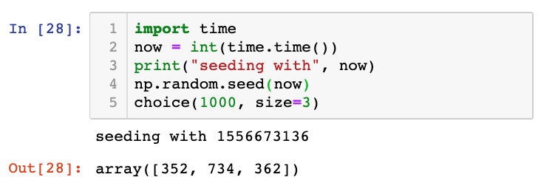
Seeding
Common approach for simulations:
seed using current time
print seed
use the seed for reproducing bugs, as necessary

Slide 38
Outline
choice()
bugs and seeding
significance
histograms
normal()

Slide 39
In a noisy world, what is noteworthy?
https://dilbert.com/strip/2001-10-25

Slide 40
Is this coin biased?
Call shenanigans?
51
49
a statistician might say we're trying to decide if the evidence that the coin isn't fair is statistically significant
whoever has the coin cheated
(it's not 50/50 heads/tails)

Slide 41
Is this coin biased?
Call shenanigans? No.
51
49

Slide 42
Is this coin biased?
Call shenanigans? No.
51
49
Call shenanigans?
5
95

Slide 43
Is this coin biased?
Call shenanigans? No.
51
49
Call shenanigans? Yes.
5
95
Note: there is a non-zero probability that a fair coin will do this, but the odds are slim

Slide 44
Is this coin biased?
Call shenanigans? No.
51
49
Call shenanigans? Yes.
5
95
Call shenanigans?
55
45
Call shenanigans?
55 million
45 million

Slide 45
Is this coin biased?
Call shenanigans? No.
51
49
Call shenanigans? Yes.
5
95
Call shenanigans? No.
55
45
Call shenanigans? Yes.
55 million
45 million

Slide 46
Is this coin biased?
Call shenanigans? No.
51
49
Call shenanigans? Yes.
5
95
large skew is good evidence of shenanigans
Call shenanigans? No.
55
45
Call shenanigans? Yes.
55 million
45 million
small skew over large samples is good evidence

Slide 47
Demo: CoinSim
Call shenanigans?
60
40
we got 10 more heads than we expect on average
how common is this?
Strategy: simulate a fair coin
"flip" it 100 times using numpy.random.choice
count heads
repeat above 10K times
[50, 61, 51, 44, 39, 43, 51, 49, 49, 38, ...]
11 more
12 less

Slide 48
Outline
choice()
bugs and seeding
significance
histograms
normal()

Slide 49
Frequencies across categories
bars are a good way to view frequencies across categories
s = Series(["rock", "rock", "paper", "scissors", "scissors", "scissors"])
s.value_counts().plot.bar(color="orange")

Slide 50
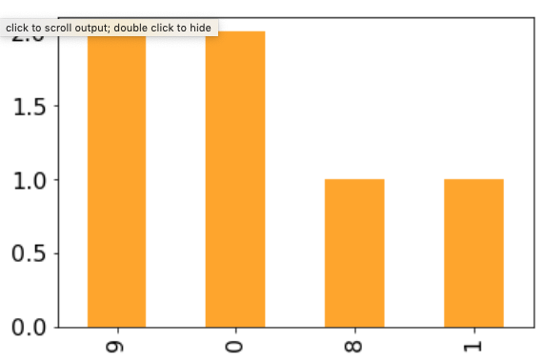
Frequencies across numbers
bars are a bad way to view frequencies across numbers
s = Series([0, 0, 1, 8, 9, 9])
s.value_counts().plot.bar(color="orange")
numbers not ordered

Slide 51
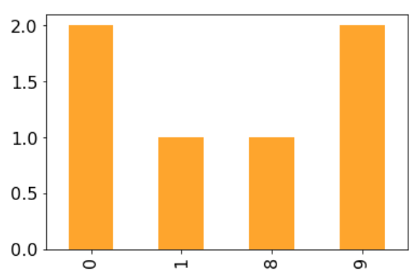
Frequencies across numbers
bars are a bad way to view frequencies across numbers
s = Series([0, 0, 1, 8, 9, 9])
s.value_counts().sort_index().plot.bar(color="orange")
gap between 1 and 8 not obvious

Slide 52
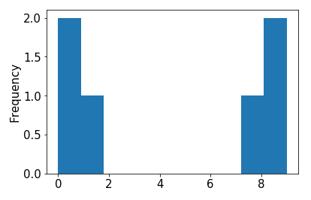
Frequencies across numbers
bars are a bad way to view frequencies across numbers
s = Series([0, 0, 1, 8, 9, 9])
s.value_counts().sort_index().plot.bar() s.plot.hist()

Slide 53
Frequencies across numbers
histograms are a good way to view frequencies across numbers
s = Series([0, 0, 1, 8, 9, 9])
s.value_counts().sort_index().plot.bar() s.plot.hist()
this kind of plot is called a histogram

Slide 54
Frequencies across numbers
histograms are a good way to view frequencies across numbers
s = Series([0.1, 0, 1, 8, 9, 9.2])
s.value_counts().sort_index().plot.bar() s.plot.hist()
both 0 and 0.1
a histogram "bins" nearby numbers to create discrete bars

Slide 55
Frequencies across numbers
histograms are a good way to view frequencies across numbers
s = Series([0.1, 0, 1, 8, 9, 9.2])
s.value_counts().sort_index().plot.bar() s.plot.hist(bins=10)
we can control the number of bins

Slide 56
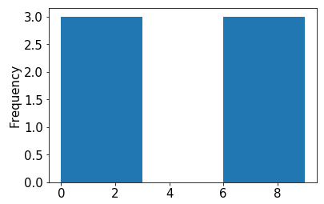
Frequencies across numbers
histograms are a good way to view frequencies across numbers
s = Series([0.1, 0, 1, 8, 9, 9.2])
s.value_counts().sort_index().plot.bar() s.plot.hist(bins=3)
too few bins provides too little detail

Slide 57
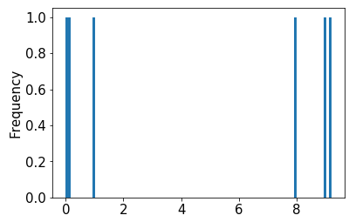
Frequencies across numbers
histograms are a good way to view frequencies across numbers
s = Series([0.1, 0, 1, 8, 9, 9.2])
s.value_counts().sort_index().plot.bar() s.plot.hist(bins=100)
too many bins provides too much detail (equally bad)

Slide 58
Frequencies across numbers
histograms are a good way to view frequencies across numbers
s = Series([0.1, 0, 1, 8, 9, 9.2])
s.value_counts().sort_index().plot.bar() s.plot.hist(bins=10)
pandas chooses the default bin boundaries

Slide 59
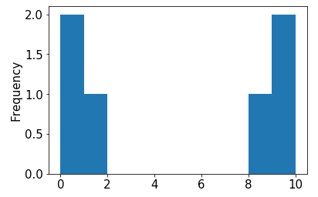
Frequencies across numbers
histograms are a good way to view frequencies across numbers
s = Series([0.1, 0, 1, 8, 9, 9.2])
s.value_counts().sort_index().plot.bar() s.plot.hist(bins=[0,1,2,3,4,5,6,7,8,9,10])
we can override the defaults

Slide 60
Frequencies across numbers
histograms are a good way to view frequencies across numbers
s = Series([0.1, 0, 1, 8, 9, 9.2])
s.value_counts().sort_index().plot.bar() s.plot.hist(bins=range(11))
this is easily done with range

Slide 61
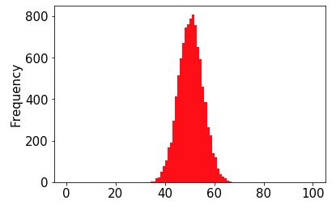
Demo: Visualize CoinSim Results
number of heads (out of 100)
numpy can directly
generate random
numbers fitting a
normal distribution
this shape resembles what we often call a normal distribution or a "bell curve"
in general, if we take large samples enough times, the sample averages will look like this (we won't discuss exceptions here)

Slide 62
Outline
choice()
bugs and seeding
significance
histograms
normal()

Slide 63
normal
from numpy.random import choice, normal
import numpy as np
for i in range(10):
print(normal())
Output:
-0.18638553993371157
0.02888452916769247
1.2474561113726423
-0.5388224399358179
-0.45143322136388525
-1.4001861112018241
0.28119371511868047
0.2608861898556597
-0.19246288728955144
0.2979572961710292
average is 0 (over many calls)
numbers closer to 0 more likely
-x just as likely as x

Slide 64
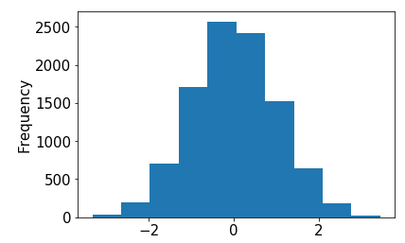
normal
from numpy.random import choice, normal
import numpy as np
s = Series(normal(size=10000))
s.plot.hist()

Slide 65
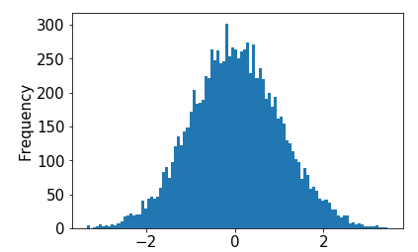
normal
from numpy.random import choice, normal
import numpy as np
s = Series(normal(size=10000))
s.plot.hist(bins=100)

